Slide 1
CHAPTER 2
PROFESSIONAL ENGINEERING BODIES

Slide 2
Professional Engineering Bodies
At the end of this chapter, students should be able to
  Explain the procedures and importance of being registered with BEM as a graduate engineer
  Describe the requirements and route to be registered as a professional engineer in Malaysia
  Describe various Professional Engineering bodies related to the field of Mechanical Engineering locally and abroad

Slide 3
2.0 Professional Engineering Bodies
Contents
2.1 The Board of Engineers Malaysia, BEM
2.2 The Institution of Engineers Malaysia, IEM
2.3 The American Society of Mechanical Engineers, ASME
2.4 The Institute of Marine Engineering Science and Technology United Kingdom (IMarEST)

Slide 4
2.1 Board of Engineers Malaysia, BEM

Slide 5
Board of Engineers Malaysia – BEM
The Board of Engineers Malaysia (BEM)
  Statutory body constituted under the Registration of Engineers Act 1967 (REA)
  Officially formed in 23rd August 1972
  BEM falls within the ambit of responsibility of the Minister of Works
  Appointment of the Board Members and the Registrar is made by the Minister

Slide 6
Board of Engineers Malaysia – BEM
  In essence, the Board is established for the purpose of regulating the professional conduct and practice of registered engineers in order to safeguard the safety and interest of the public

Slide 7
Composition of BEM
BEM consists of 17 Board Members comprising of
  President
  14 Professional Engineers:
    5 public sector
    5 private practice
    2 from local authority or statutory authority
    2 private sector (full time employment)
  1 representative of the Board of Architects
  Malaysia
  1 representative of the Quantity Surveyors
  Malaysia

Slide 8
Functions of BEM
The functions are
  Maintaining the Register
  Processing Applications for Registration
  BEM through its Examination and Qualification Committee conducts the Professional Assessment Examination (PAE)
    Assess the quality of experience gained by the Graduate Engineers and his competency

Slide 9
Functions of BEM
  Every application for registration, be it as Graduate Engineers, Professional Engineers, Engineering Consultancy Practices or Temporary Engineers by foreign engineers is scrutinized thoroughly by the Application Committee
    Ensure compliance with the Act and with the policy of BEM

Slide 10
Assessment of Academic Qualifications
BEM through its Engineering Accreditation Council (EAC) assesses and accredits engineering degrees offered by institutions of higher learning
The EAC is the co-ordinating body on accreditation, representing the BEM, IEM, Lembaga Akreditasi Negara (LAN) and Jabatan Perkhidmatan Awam Malaysia (JPA)
The accreditation team visits the institution to audit the facilities and have dialogue with academic staff and students

Slide 11
Regulating the Conduct and Ethics of the Engineering Profession
BEM has been a medium for the engineers to decide on matters relating to their professional conduct or ethics
  Any matter concerning the professional conduct of registered engineers will be studied by the Board to determine whether there is a breach of professional ethics or code
  Scale of Fees
    Scale of Fees Committee of BEM continues to have dialogues sessions with the Federal Treasury on issues involving mode of remuneration, quantum and conditions of payment

Slide 12
Publication
Publication Committee of BEM undertakes the task of promoting engineering profession through Buletin Ingenieur and other printed materials
Bulletin Ingenieur (4 issues per year: March, June, Sept and December) is used as a communication tool for BEM to disseminate information on the activities of the Board, regulations, code of ethics, career development, update and guidelines and such other news as decided by the Board

Slide 13
Promotion of Continued Learning and Education
BEM will consider providing financial assistance to seminar or conference which is organised by a non-profit making organisation.
BEM would also consider giving grant to selected type of study or contribute prizes for selected engineering competition. BEM also purchase engineering reference books which all engineers have access to in the library.

Slide 14
GRADUATE ENGINEERS REQUIREMENTS AND PROCEDURES
Any person who wants to take up employment as an engineer must be registered as a Graduate Engineer with BEM
BEM recognises the experience gained by an engineering graduate only after he has registered as a Graduate Engineer
As such, it is prudent for an engineering graduate to register as a Graduate Engineer at the very beginning of his engineering career

Slide 15
REQUIREMENT FOR REGISTRATION AS A GRADUATE ENGINEER
The recognised academic qualification for registration as a Graduate Engineer with BEM includes the following
  An engineering degree accredited/ recognised by BEM available in an approved list maintained by BEM
  A pass in Part I & Part II of the Engineering Council Examination of United Kingdom or
  Part I & Part II of the IEM/BEM Graduate Examination in any particular branch

Slide 16
BRANCHES OF ENGINEERING
For graduate registration, the candidate will be placed in the branch as stated in his basic degree certificate
BEM registers engineers in 86 different disciplines

Slide 17
PROCEDURES FOR REGISTRATION AS A GRADUATE ENGINEER
Registration procedure
  The applicant shall submit his application in Form A
  The completed Form A shall be submitted together with
      Certified copy of the degree certificate
      Certified copy of the transcript of academic record or detail of course and subjects taken which is issued by the university
      Certified copy of Identity Card
      Processing fee of RM50.00

Slide 18
PROCEDURES FOR REGISTRATION AS A GRADUATE ENGINEER
Registration procedure
  The certified copy of the degree certificate from a foreign university which is not in the English language shall be accompanied by a translation of it in Bahasa Melayu or English
  Every document submitted must be certified as a true copy by a Professional Engineer who is registered with BEM

Slide 19
PROCEDURES FOR REGISTRATION AS A GRADUATE ENGINEER
Registration procedure
  An applicant whose application is approved will be notified accordingly by letter
    The letter of notification would state the registration number and the branch of engineering in which the applicant is registered
    Branch of engineering eligible will be assessed by the board based on transcript submitted
  The application will be decided upon by BEM within four months from the date of receipt of complete application

Slide 20
ENQUIRIES
All application and enquiries pertaining to registration & accreditation shall be addressed to:
Registration Department
Board of Engineers Malaysia
Tingkat 17, Ibu Pejabat JKR
Kompleks Kerja Raya Malaysia
Jalan Sultan Salahuddin
50580 Kuala Lumpur
Tel: 03-2691 1011 ext. 7095/7096
03-2696 7095 / 7096
Fax: 03 - 2692 5017
E-mail: application@bem.org.my

Slide 21
2.1.1 Route To Professional Engineer

Slide 22
ROUTE TO A PROFESSIONAL ENGINEER
  Any candidate who applies for registration as a Professional Engineer must:
    Be registered as a Graduate Engineer with BEM; and
    Have satisfied the training requirements of BEM; and
    Have passed the Professional Assessment Examination (PAE) of BEM or be elected as a Corporate Member of the Institution of Engineers Malaysia (IEM); and
    Have been residing in Malaysia for a period of not less than six months immediately prior to the date of application

Slide 23
ROUTE TO A PROFESSIONAL ENGINEER
Graduate Engineer
PI Routes
1. Practicing Engineer Candidate
2. Teacher in Engineering Candidate
3. Researcher in Engineering Candidate

Slide 24


ROUTE TO A PROFESSIONAL ENGINEER
Without practicing certificate
Registration as Graduate Engineer
with BEM
Practical Experience of Minimum 3 years
As presented in Regulation 22(1) of the
Registration of Engineers Regulation 1990
Mandatory Course Attendance *
Professional Development *
Competency Assessment Examination*
* NEW REQUIREMENTS
IEM Professional
Interview
Professional Assessment Examination
(PAE) Conducted by BEM
IEM Corporate Member
Apply to BEM for Registration as a
Professional Engineer

Slide 25


ROUTE TO A PROFESSIONAL ENGINEER
With practicing certificate
Professional Engineer
Professional Competency Examination
(PCE)
* NEW REQUIREMENTS
Professional Engineer
With Practicing Certificate

Slide 26
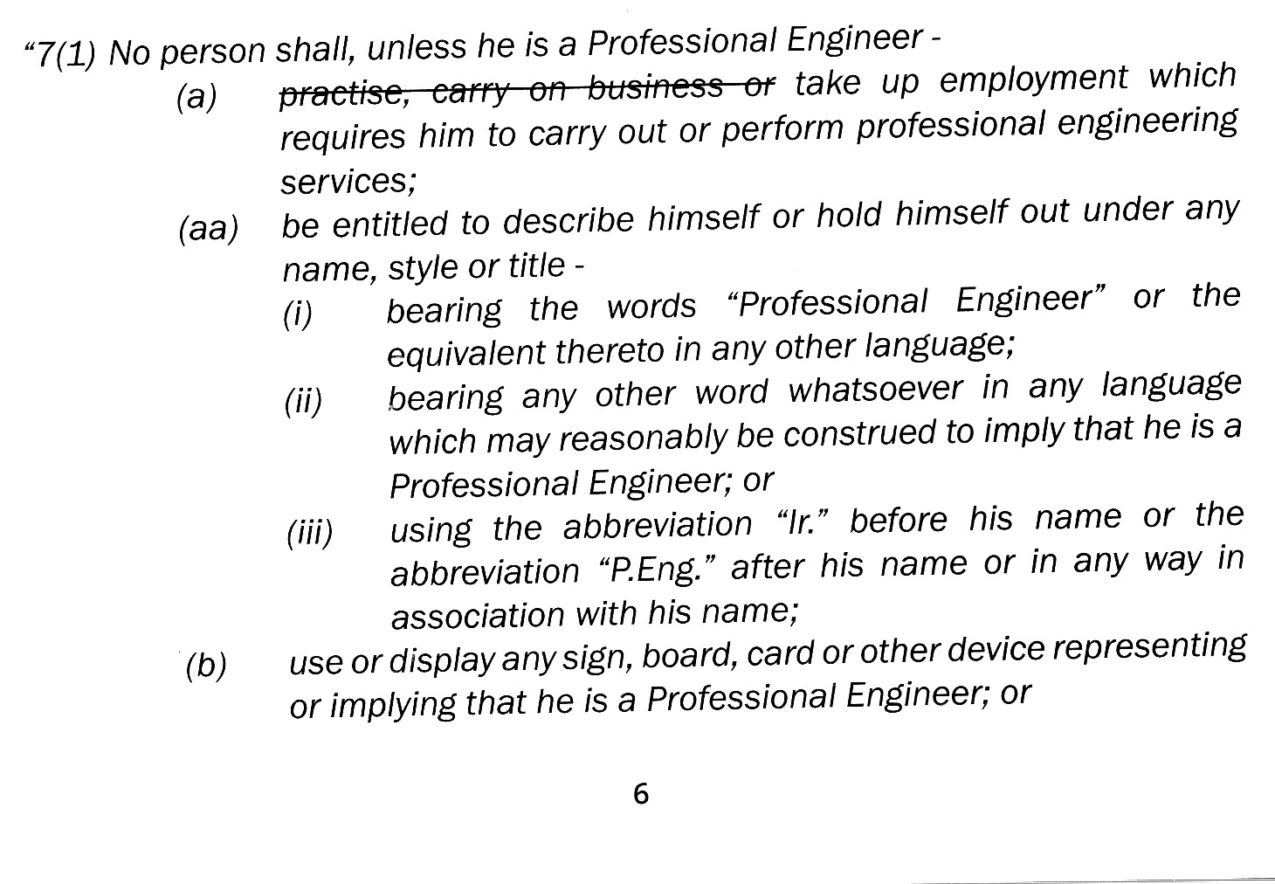
ROUTE TO A PROFESSIONAL ENGINEER
Without practicing certificate
Section 7(1) of the amended REA;

Slide 27
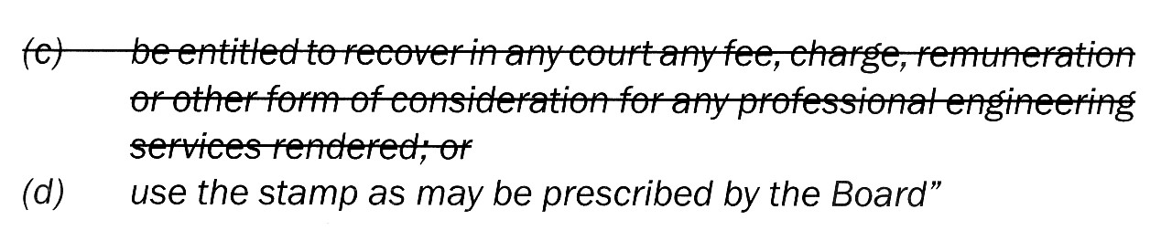
ROUTE TO A PROFESSIONAL ENGINEER
Without practicing certificate

Slide 28
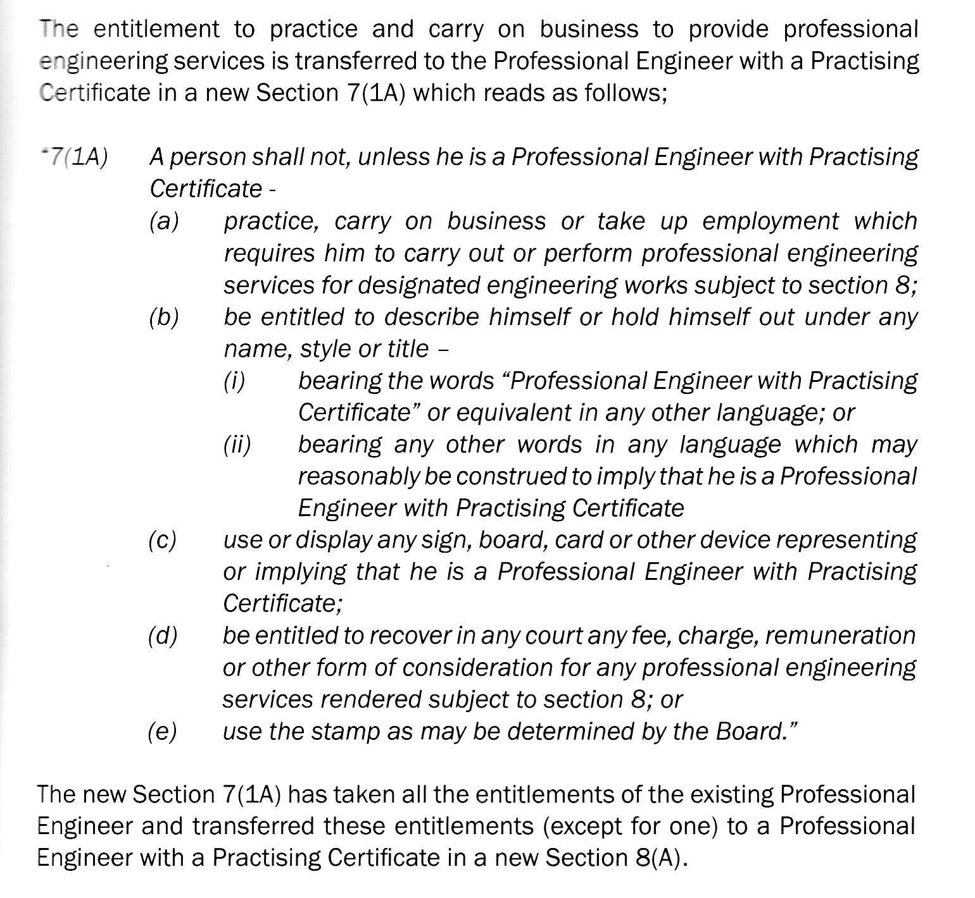
ROUTE TO A PROFESSIONAL ENGINEER
With practicing certificate

Slide 29
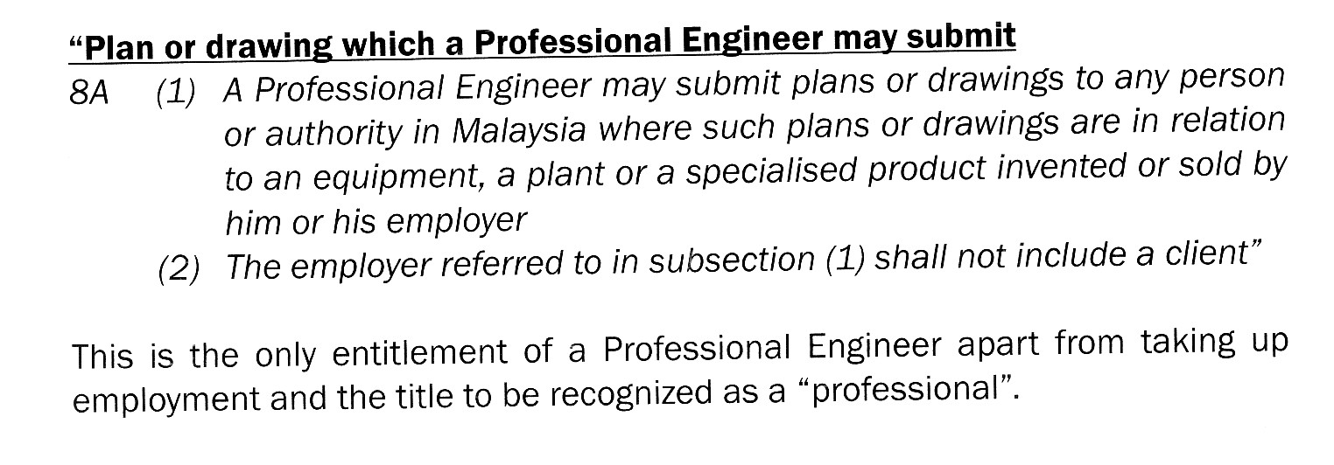
ROUTE TO A PROFESSIONAL ENGINEER
Without practicing certificate

Slide 30
TRAINING REQUIREMENTS
The practical experience that a registered Graduate Engineer is required to obtain under Section 10 (1) (b) of the Act in order to be entitled to apply for registration as a Professional Engineer shall be carried out in a manner satisfactory to the Board for a period of three years

Slide 31
TRAINING REQUIREMENTS
  in the planning, design, execution or management of such works as comprised within the profession of engineering;
    in engineering research; or
    in the teaching in a course leading to a qualification in engineering research; or
    in the teaching in a course leading to a qualification approved by the Board, and at least one Year of such practical experience shall be obtained in Malaysia under the supervision of a registered Profession Engineer of the same discipline or an approved allied discipline and shall be in fields of engineering practice other than in research or teaching

Slide 32
TRAINING REQUIREMENT
Where there is no Professional Engineer of the same or allied discipline as the candidate in the organisation in which the candidate is working, he may seek the approval from BEM to obtain a Professional Engineer from outside his organisation to supervise his training
The total practical experience to be obtained shall not be less than three years
After the candidate has completed the required prescribed training, he may apply to sit for the Professional Assessment Examination (PAE) conducted by BEM

Slide 33
NEW REQUIREMENTS
From January 1, 2007, the PAE would be conducted solely by IEM on behalf of BEM
New requirements as in BEM circular No. 2/2005
New Competency Assessment Examination (CAE)
From January 1, 2008, candidates who want to sit for the PAE will also have to sit for an additional competency examination (CAE)
The CAE will cover competency in the practice as well as in the laws of the land

Slide 36
ENTITLEMENT OF A PROFESSIONAL ENGINEER
Ingeniur : use of prefix Ir
Professional Engineer : use of P.Eng at end
  Example: Ir. Wan Khairuddin Wan Ali, P.Eng

Slide 37
2.1.2 Professional Assessment Examination, PAE

Slide 38
PROFESSIONAL ASSESSMENT EXAMINATION (PAE)
REQUIREMENTS & PROCEDURES
  Application Form G is to be submitted together with the prescribed fee of RM200.00
  On approval of the application, BEM shall appoint a Principal Examiner who in turn shall appoint a Second Examiner
    The Examiners shall be either of the same or approved allied discipline as that of the candidate.

Slide 39
PROFESSIONAL ASSESSMENT EXAMINATION (PAE)
  The Principal Examiner shall write to the candidate advising the date by which the documents required for the Examination are to be sent to him and the place, time and date of the Examination
  All documents required by the Principal Examiner shall be sent to him by post
  The documents shall be accompanied by a completed BEM/Form/PAE/02 (Form I)
  PAE will consist of professional interview, followed by essay writing
  In the professional interview, the practical experience of the candidate will be assessed by the Examiners both on time and quality basis
  The Examiners shall test the candidate during the interview on the following aspects:
    Understanding of the application of engineering principles to the solution of problems arising from the investigation, planning, design, construction, operation or maintenance of engineering works; or on the subject of his research; and
    The ability to communicate

Slide 40
PROFESSIONAL ASSESSMENT EXAMINATION (PAE)
  The candidate is required to write two essays, one each from Section A and Section B. Section A is for an essay related to the candidate's training and experience as stated in his report
    Essay for Section B will be on the code of ethics
  The candidate will be required to choose one out of two questions from Section A
    Candidate is also required to answer a question from two alternative questions selected by the examiners on code of professional conduct (Section B)
  1 1/2 hours will be allowed for each written paper
  The essays are intended primarily to test the candidate's ability to marshal his knowledge and thoughts and to express them in words in a clear and concise manner

Slide 41
2.1.3 Documents Preparation for PAE

Slide 42
PREPARATION OF DOCUMENTS FOR PROFESSIONAL ASSESSMENT EXAMINATION (PAE)
A - GENERAL REQUIREMENTS
  Every candidate for the Examination shall submit the following documents
    Two copies of a typewritten report, giving an account of his training and experience
    Single copy of other documents and/or drawings
  Every drawing and document shall be certified by a Professional Engineer who is in a responsible position as the employer or the principal for whom or under whom it was prepared
    In the case of overseas experience, the drawings and documents may be signed by a Professional Engineer
  The Professional Engineer must certify on BEM/Form/PAE/02 (Form I) that the documents and drawings submitted are the work of the candidate

Slide 43
PREPARATION OF DOCUMENTS FOR PROFESSIONAL ASSESSMENT EXAMINATION (PAE)
Submission of the Report
  The report on training and experience should be of length 1500 - 2000 words and be typewritten on A4 paper
  The report shall include organisations in which the candidate has worked (in chronological order) together with the positions held
  The duties and responsibilities in each organisation together with the works done/projects undertaken and training undergone should be stated
  The actual involvement of the candidate in the projects undertaken and experience gained is to be emphasized
  At the end of the report, the candidate should give a summary of the total time spent (since registration as a Graduate Engineer) in months on the following aspects:
    office/design work
    site/field experience
    planning/management, and
    others (research, teaching etc.)

Slide 44
PREPARATION OF DOCUMENTS FOR PROFESSIONAL ASSESSMENT EXAMINATION (PAE)
Submission of the Drawings/Documents
  Consideration 1
    At least two and not more than four working drawings related to the candidate's own work; detailed design calculations prepared by him relating to one or more of the aforesaid drawings; specifications and a set of quantities, comprising abstract, takeoff sheets or shop list all prepared by him relating either to one of the aforesaid drawings, or to other drawings which must also be submitted
    A candidate may submit an additional drawing not necessarily prepared by him, to illustrate his experience in engineering works

Slide 45
PREPARATION OF DOCUMENTS FOR PROFESSIONAL ASSESSMENT EXAMINATION (PAE)
  OR
  Consideration 2
    The candidate must submit part of a feasibility study involving functional and economic comparison of the preliminary designs of an engineering system, or a comprehensive report of a major engineering project, or a system design of a major engineering works
    The above documents should include the following
      At least one relevant drawing showing essential features of details of the project or system
      Where appropriate at least three and not more than six sketches containing sufficient details to enable a draughtsman to work them up into working drawings without further guidance
      Preliminary stress or system analysis, where applicable, and
      Quantities, cost analysis or economic analysis as appropriate

Slide 46
PREPARATION OF DOCUMENTS FOR PROFESSIONAL ASSESSMENT EXAMINATION (PAE)
  OR
  Consideration 3
    In the case of a candidate whose experience is in the installation or operation or maintenance of an engineering plant or engineering system, a detailed description of the installation or operation or maintenance of the plant or system together with the appropriate schedule which he has formulated must be submitted
    In his submission, he should clearly indicate his contribution which shows application of sound engineering principles
    A critical appraisal of the design of the engineering system which may not necessarily be the work of the candidate, should be included
    Details of modifications, if any, made to the existing system as a result of the work of the candidate should also be submitted

Slide 47
PREPARATION OF DOCUMENTS FOR PROFESSIONAL ASSESSMENT EXAMINATION (PAE)
  OR
  Consideration 4 (FOR CANDIDATES ENGAGED IN RESEARCH & TEACHING)
    In the case of a candidate engaged in research and teaching, two copies of a report of not more than 4000 words in evidence of the research carried out by him should be submitted
    This report should include a brief summary of the candidate's research work, stating the subject matter and objectives, together with a short list of any papers he has published
    A thesis prepared for a higher degree is not acceptable but the candidate may include the matter of this thesis together with the new matter

Slide 48
Statistics
Total Number of Engineers Registered With BEM (as of 31 December 2009)
 | 2009 | 2015
Professional Engineers (Ir) | 14,084 | 11,387
Graduate Members | 52,350 | 86,259
TOTAL NO. OF ENGINEERS | 66,434 | 97,646

Slide 49
2.2 The Institution of Engineers Malaysia, IEM

Slide 50
Introduction to IEM
The Institution of Engineers, Malaysia also known as IEM
  A professional learned society serving more than 15,000 members in Malaysia, overseas and the communities in, which they work
  Formed in 1959 and started out with 60 members
  Membership has increased to 23,309 (data as of 31 March 2011), making it the largest professional body in Malaysia
  The Corporate member of IEM can apply to BEM for registration as a Professional Engineer
  Currently, the IEM has five (5) official representatives on the BEM

Slide 51
TYPE OF IEM MEMBERSHIP
Student Member – open to all engineering students
Graduate Member – open to all practicing engineers registered with BEM
Corporate / Fellow Member – upgrading for experience engineers leading to Professional Engineer status
Associate Member – non-degree engineering practitioner; diploma or certificate holders
Incorporated Member – Professional Engineers from international Engineering Institution recognized by IEM
Honorary Member – distinguish person who contributed to engineering profession

Slide 52
BENEFITS OF IEM MEMBERSHIP
Establish networking groups amongst engineers
Attend Technical Talks, Seminars or Courses and Technical Visits
Attend Professional Development Program (PDP)
Route to Professional Engineers
Attend Continuing Professional Development (CPD)

Slide 53
IEM OFFICES
IEM Southern Branch:
24-B, Jalan Abiad, Taman Tebrau Jaya
80400 Johor Bahru
Tel: 07-331 9705
Head-Quarters:
Bangunan Ingenieur, Lot 60/62, Jalan 52/4,
Peti Surat 223
46720 Petaling Jaya, Selangor
Tel: 03-79684001

Slide 54
2.3 The American Society of Mechanical Engineers, ASME

Slide 55
The American Society of Mechanical Engineers, ASME
ASME is a not-for-profit membership organization that enables collaboration, knowledge sharing, career enrichment, and skills development across all engineering disciplines
Founded in 1880 by a small group of leading industrialists, ASME has grown through the decades to include more than 120,000 members in over 140 countries around the globe
ASME’s diverse members range from college students and early-career engineers to project managers, corporate executives, researchers and academic leaders
ASME serves this wide-ranging technical community through quality programs in continuing education, training and professional development, standards and certification, research, conferences and publications, government relations, and other forms of outreach
ASME issued its first standard, Code for the Conduct of Trials of Steam Boilers, in 1914, starting a development process that has grown to more than 500 codes and standards

Slide 56
2.4 The Institute of Marine Engineering Science and Technology (IMarEST) UK

Slide 57
The Institute of Marine Engineering Science and Technology (IMarEST) UK
The IMarEST was established in London in 1889 then known as The Institute of Marine Engineers but in 2002 changed to IMarEST incorporating marine professional from the marine science and technology segments and is the largest international membership body and learned society for marine professionals with over 15,000 members worldwide
It has branch offices in 50 countries and a presence in 100 countries worldwide

Slide 58
The Institute of Marine Engineering Science and Technology (IMarEST) UK
Benefits
  Professional status and recognition: various grades of membership, professional registers e.g CEng, CMar Eng, IEng , EngTech under the Engineering Council of UK and under the Science Council of UK, CSci, RMarSci
  Access to global marine community
  Become part of the marine tradiion. Over 120 years of the Institute’s existence the leaders of IMarEST have traditionally been involved in the furtherance of the marine technology advancements
  Opportunity – access to the IMarEST employment service, obtain career advise, support and mentoring
  Consultation – getting involved with international and national level forum and conferences

Slide 59
………….End of Chapter 2

