Slide 1
CHAPTER 5 HEALTH & SAFETY

Slide 2
Chapter 5 SAFETY AND HEALTH
At the end of this chapter, students should be able to
discuss rules and regulations in typical engineering works related to safety and health

Slide 3
5.0 SAFETY & HEALTH
Contents
5.1 Factory and Machinery Act, 1967
5.2 Occupational Safety & Health Act 1994
(Act 514)
5.3 Occupational Safety & Health Management Systems
5.4 Industrial Safety in Malaysia

Slide 4
5.1 Factory and Machinery Act, 1967

Slide 5
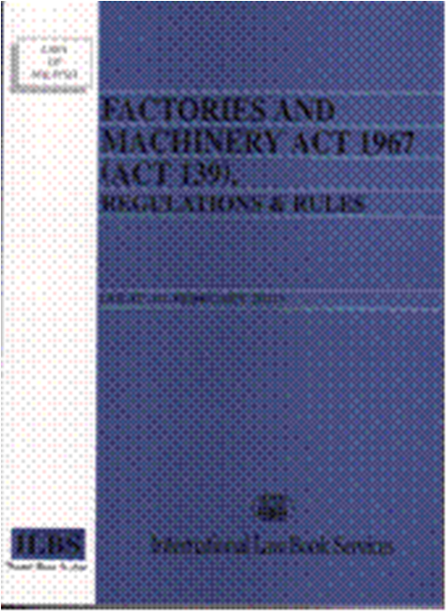
5.1 Factory and Machinery Act, 1967

Slide 6
5.1 Factory and Machinery Act, 1967
To address safety and health issues at the workplace, the government has developed a set of policies on occupational safety and health that are clear and coherent
The first protective legislation was enacted in 1967, referred to as the Factories and Machinery Act
With the enactment of this Act, the Factories and Machinery Department was established under the Ministry of Human Resources, which was then known as the Ministry of Labour, to provide a governmental platform for enforcement of occupational safety and health legislations

Slide 7
5.1 Factory and Machinery Act, 1967
But the Act only covered safety and limited health aspects in the manufacturing, mining, and construction sectors
As such, the Factories and Machinery Department was only mandated to enforce policies and regulations in these sectors and no others
As the country’s economy grew and diversified, the government felt the need to expand protective legislations to cover the safety and health of all workers. So, in 1994, a new Act, referred to as the Occupational Safety and Health Act (OSHA) was passed

Slide 8
5.2 Occupational Safety & Health Act 1994 (Act 514)

Slide 9
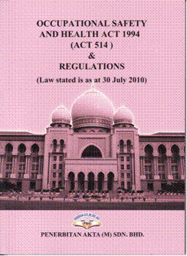
5.2 OCCUPATIONAL SAFETY AND HEALTH ACT 1994 (Act 514)

Slide 10
5.2 OCCUPATIONAL SAFETY AND HEALTH ACT 1994 (Act 514)
Under the OSHA, the responsibility of enforcing occupational safety and health policies and regulations still resided with the Factories and Machinery Department, which was renamed as the Department of Occupational Safety and Health (DOSH)
DOSH is now responsible for safeguarding the safety and health of all workers in Malaysia
An OSH Information Centre has been set up at the National Institute of Occupational Safety and Health (NIOSH)

Slide 11
5.2 OCCUPATIONAL SAFETY AND HEALTH ACT 1994 (Act 514)
Part I – PRELIMINARY
This Act applies throughout Malaysia to the industries specified in the First Schedule
The provisions of this Act shall be in addition to, and not in derogation of, the provisions of any other written law relating to occupational safety and health

Slide 12
5.2 OCCUPATIONAL SAFETY AND HEALTH ACT 1994 (Act 514)
Part I – PRELIMINARY
The objectives of this Act are-
(a) to secure the safety, health and welfare of persons at work against risks to safety or health arising out of the activities of persons at work;
(b) to protect person at a place of work other than persons at work against risks to safety or health arising out of the activities of persons at work;

Slide 13
5.2 OCCUPATIONAL SAFETY AND HEALTH ACT 1994 (Act 514)
Part I – PRELIMINARY
The objectives of this Act are-
(c) to promote an occupational environment for persons at work which is adapted to their physiological and psychological needs;
(d) to provide the means whereby the associated occupational safety and health legislations may be progressively replaced by a system of regulations and approved industry codes of practice operating in combination with the provisions of this Act designed to maintain or improve the standards of safety and health

Slide 14
5.2 OCCUPATIONAL SAFETY AND HEALTH ACT 1994 (Act 514)
Part II explains the appointment of officers
Part III deals with the National Council for Occupational Safety and health:
Membership of the council
Powers and functions of the council

Slide 15
5.2 OCCUPATIONAL SAFETY AND HEALTH ACT 1994 (Act 514)
Part V describes the general duties of designers, manufacturers and suppliers
General duties of manufacturers, etc. as regards with plant used at work
General duties of manufacturers, etc. as regards with substances used at work
Penalty for an offence

Slide 16
5.2 OCCUPATIONAL SAFETY AND HEALTH ACT 1994 (Act 514)
Part VI explains the general duties of employees:
General duties of employees at work
An employer who, or a trade union which, contravenes the provisions of this section shall be guilty of an offence and shall, on conviction, be liable to a fine not exceeding ten thousand ringgit or to a term of imprisonment not exceeding one year or to both

Slide 17
5.2 OCCUPATIONAL SAFETY AND HEALTH ACT 1994 (Act 514)
Part VI explains the general duties of employees:
Discrimination against employee:
No employer shall dismiss an employee, injure him in his employment, or alter his position to his detriment by reason only that the employee-
(a) makes a complaint about a matter which he considers is not safe or is a risk to health;
(b) is a member of a safety and health committee established pursuant to this Act; or
(c) exercises any of his functions as a member of the safety and health committee

Slide 18
5.2 OCCUPATIONAL SAFETY AND HEALTH ACT 1994 (Act 514)
Part VII deals with safety and health organizations:
Safety and health officer
Establishment of safety and health committee at place of work
Functions of safety and health committee

Slide 19
5.2 OCCUPATIONAL SAFETY AND HEALTH ACT 1994 (Act 514)
Part VIII explains the procedures for notification of accidents, dangerous occurrence, occupational poisoning and occupational diseases and inquiry
Part IX explains the prohibition against use of plant or substance
Part X deals with the industry codes of practice
Part XI describes matters regarding to enforcement and investigation
Part XII explains the liability for offences

Slide 20
5.2 OCCUPATIONAL SAFETY AND HEALTH ACT 1994 (Act 514)
Part XIII is on appeals
Part XIV is on regulations

Slide 21
5.2 OCCUPATIONAL SAFETY AND HEALTH ACT 1994 (Act 514)
Part XV which discusses miscellaneous matters such as the duty to keep secret:
(1) Save for an inquiry under this Act or in any court proceedings relating to the commission of an offence under this Act, no person shall disclose any matter including any manufacturing or commercial secret which has come to his knowledge or which he has acquired while performing his duties under this Act

Slide 22
5.2 OCCUPATIONAL SAFETY AND HEALTH ACT 1994 (Act 514)
Part XV which discusses miscellaneous matters such as the duty to keep secret:
(2) A person who contravenes the provision of this section shall be guilty of an offence and shall, on conviction, be liable to a fine not exceeding twenty thousand ringgit or to imprisonment for a term not exceeding two years or to both

Slide 23
5.3 Occupational Safety & Health Management Systems

Slide 24
5.3 OCCUPATIONAL SAFETY & HEALTH MANAGEMENT SYSTEMS
Legislation is essential but insufficient on its own to address these changes or to keep pace with new hazards and risks
Organizations must also be able to tackle occupational safety and health challenges continuously and to build effective responses into dynamic management strategies
Occupational safety and health, including compliance with the OSH requirements pursuant to national laws and regulations, are the responsibility and duty of the employer

Slide 25
5.3 OCCUPATIONAL SAFETY & HEALTH MANAGEMENT SYSTEMS
The employer should show strong leadership and commitment to OSH activities in the organization, and make appropriate arrangements for the establishment of an OSH management system
The system should contain the main elements of:
policy
organizing
planning and implementation
evaluation
action for improvement

Slide 26
5.3 OCCUPATIONAL SAFETY & HEALTH MANAGEMENT SYSTEMS
Policy:
The employer, in consultation with workers and their representatives, should set out in writing an OSH policy, which should be:
(a) specific to the organization and appropriate to its size and the nature of its activities
(b) concise, clearly written, dated and made effective by the signature or endorsement of the employer or the most senior accountable person in the organization
(c) communicated and readily accessible to all persons at their place of work
(d) reviewed for continuing suitability
(e) made available to relevant external interested parties, as appropriate

Slide 27
5.3 OCCUPATIONAL SAFETY & HEALTH MANAGEMENT SYSTEMS
Policy:
Worker participation is an essential element of the OSH management system in the organization
The employer should ensure that workers and their safety and health representatives are consulted, informed and trained on all aspects of OSH, including emergency arrangements, associated with their work

Slide 28
5.3 OCCUPATIONAL SAFETY & HEALTH MANAGEMENT SYSTEMS
Organizing:
Responsibility and accountability
The employer should have overall responsibility for the protection of workers' safety and health, and provide leadership for OSH activities in the organization
The employer and senior management should allocate responsibility, accountability and authority for the development, implementation and performance of the OSH management system and the achievement of the relevant OSH objectives

Slide 29
5.3 OCCUPATIONAL SAFETY & HEALTH MANAGEMENT SYSTEMS
Organizing:
Competence and training
Occupational safety and health management system documentation
Communication

Slide 30
5.3 OCCUPATIONAL SAFETY & HEALTH MANAGEMENT SYSTEMS
Planning and implementation :
Initial review
System planning, development and implementation
Emergency prevention, preparedness and response

Slide 31
5.3 OCCUPATIONAL SAFETY & HEALTH MANAGEMENT SYSTEMS
Planning and implementation :
Hazard prevention
Preventive and protective measures should be
implemented in the following order of priority:
(a) eliminate the hazard/risk;
(b) control the hazard/risk at source, through the use of engineering controls or organizational measures;
(c) minimize the hazard/risk by the design of safe work systems, which include administrative control measures; and
(d) where residual hazards/risks cannot be controlled by collective measures, the employer should provide for appropriate personal protective equipment, including clothing, at no cost, and should implement measures to ensure its use and maintenance

Slide 32
5.3 OCCUPATIONAL SAFETY & HEALTH MANAGEMENT SYSTEMS
Evaluation
Performance monitoring and measurement
Investigation of work-related injuries, ill health, diseases and incidents, and their impact on safety and health performance
Audit
Management review

Slide 33
5.3 OCCUPATIONAL SAFETY & HEALTH MANAGEMENT SYSTEMS
Action for improvement
Preventive and corrective action
Continual improvement

Slide 34
5.4 Industrial Safety In Malaysia

Slide 35
5.4 Industrial Safety in Malaysia
Generally accidents are classified under 3 different categories:
Type
Agency
Industry
The classification according to types gives the most useful information
The type of accident can be associated with certain aspects of industrial safety

Slide 36
5.4 Industrial Safety in Malaysia
Classification of accidents according to type | Aspect of Industrial Safety
A12 Fall of person on the same level A31 Stepping on objects A32 Striking against stationary objects | Industrial housekeeping
A33 Striking against moving objects A42 Caught between stationary and moving objects A43 Caught between moving objects | Guarding

Slide 37
5.4 Industrial Safety in Malaysia
Classification of accidents according to type | Aspect of Industrial Safety
A23 Struck by falling objects during handling A51 Over exertion in lifting objects A52 Over exertion in pushing or pulling objects A54 Strenuous movements | Materials handling
A61 Exposure to heat A63 Contact with hot objects A70 Expose or contact with electric current | Personal protective equipment

Slide 38
5.4 Industrial Safety in Malaysia
Guarding of Machinery and Mechanism
Accidents happen due to the followings:
Supervisors not using safe procedures during maintenance or breakdown
Operators not properly attired
Unsafe acts by operators

Slide 39
5.4 Industrial Safety in Malaysia
Industrial Housekeeping
Smaller factories
Movement of materials is haphazard
Fire prevention is minimal
Poor housekeeping seems to be a tradition – resistance to change is great

Slide 40
5.4 Industrial Safety in Malaysia
Materials handling
Caused by unsafe work practices – improper lifting, overloading, failure to wear protective clothing etc
Strains, sprain, fractures and bruises are common injuries
Requires training in safe working habits and adequate supervision

Slide 41
5.4 Industrial Safety in Malaysia
Industrial hazards
The basic step of preventing accidental injury is to eliminate the hazards by:
Engineering the hazards out of the operations
Controlling the hazard at its source by an enclosure or a guard
Prescribing personal protective clothing as a shield

Slide 42
5.4 Industrial Safety in Malaysia
The followings are examples of accidents and statistics obtained from the official website of the Department of Safety and Health Malaysia(DOSH)
Summary of accident cases reported by DOSH as at 12 August 2011

Slide 43
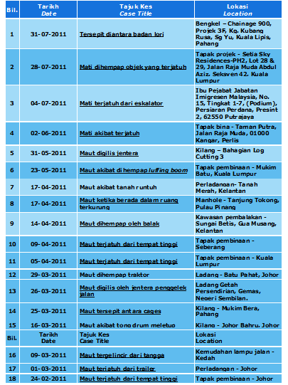
5.4 Industrial Safety in Malaysia

Slide 44
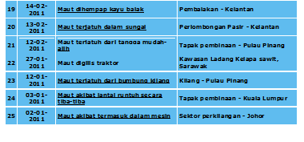
5.4 Industrial Safety in Malaysia

Slide 45
5.4 Industrial Safety in Malaysia
Statistics from DOSH indicates that the Manufacturing sector has the highest occupational accident rate

Slide 46
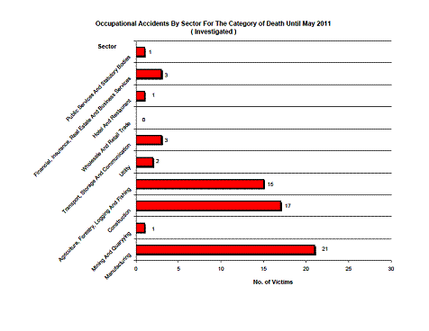
5.4 Industrial Safety in Malaysia

Slide 47
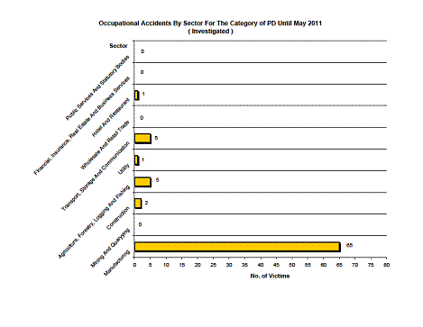
5.4 Industrial Safety in Malaysia

Slide 48
5.4 Industrial Safety in Malaysia
Example of an accident case
LPG Explosion in a supermarket, December 2009
Case synopsis
Two workers were killed and nine injured when an explosion occurred inside a new shopping complex in Malacca
During the accident, the workers were making final preparations for the official opening of the complex

Slide 49
5.4 Industrial Safety in Malaysia
Example of an accident case
The LPG was channeled from the bulk storage tanks through a gas piping network and controlled by a shut-off valve at each of the shop-lot- which is used as a food and beverages outlet
Forensic engineering investigation found out that the explosion happened when a shut-off valve in one of the shop-lots was inadvertently left opened

Slide 50
5.4 Industrial Safety in Malaysia
Example of an accident case
The LPG leakage was detected and discovered by the one of the workers working near the shop-lot
However no action was taken to evacuate the building and the shut-off valve inside the shop-lot cannot be turned off because the door was shuttered and locked
The LPG which had escaped and accumulated in the shop–lot can be easily ignited by any sparks from the on-going work outside the shop
The combination of accumulated LPG and spark caused a confined vapor cloud explosion (VCE)

Slide 51
5.4 Industrial Safety in Malaysia
Example of accident cases
This resulted in building walls being cracked and damaged, window glasses shattered and ceilings collapsed
Death and injuries were due to flying debris from the explosion

Slide 52
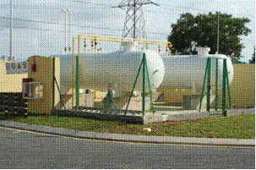
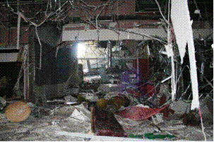
5.4 Industrial Safety in Malaysia
Gas Supply From 2 LPG Tanks
Damages caused by the explosion

Slide 53
5.4 Industrial Safety in Malaysia
Lessons learnt and recommendations:
A comprehensive LPG safe system of work need to be established. On top of that the management must ensure that the system is implemented and followed through by anyone who works with LPG
2. Thorough inspection on the LPG piping and fittings need to be done before the commissioning process to ensure that all shut-off valves in the shop-lots were properly turned off
3. The gas piping contractor shall ensure that the end pipes were closed with ‘end caps’ to prevent any leakage of gas even though the shut-off valves were closed

Slide 54
5.4 Industrial Safety in Malaysia
Lessons learnt and recommendations:
4. The contractor should be briefed about the dangers of LPG and the safety evacuation measures to be taken in the event of any leakage
5. To ensure good ventilation in the building, especially for enclosed and confined places where LPG could accumulate if a leakage occur
6. The location of the LPG main emergency shut-off valve shall be easily and readily accessible

Slide 55
………….End of Chapter 5

